Slide 1
EED CA3
Team 7: ElderTrack
Done By: Ahmad Rifaaie Bin Mohamed Ali(1800962)
Cai Yanru (1840522)

Slide 2
Problem Statement
How do we ensure that these elderly are under constant attention and are cared for?

Slide 3

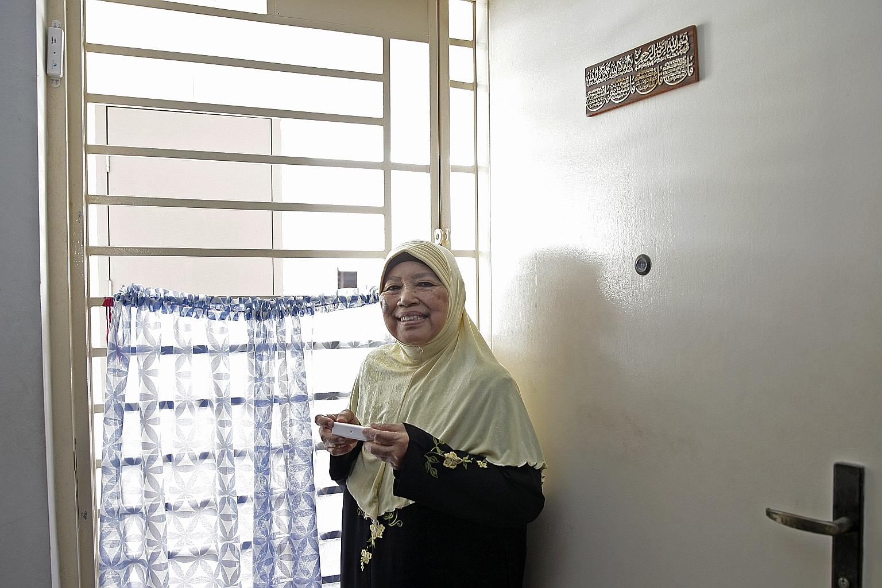
Background
With an increasing elderly population, Singapore will need to be able to take care of them.
Some elderly prefer to live in their own homes, rather than nursing homes.
Elderly prefer older technology, and may feel not so reluctant to current technology.

Slide 4


Needs of User: Elderly
Require constant attention
Activities that are simple and easy

Slide 5
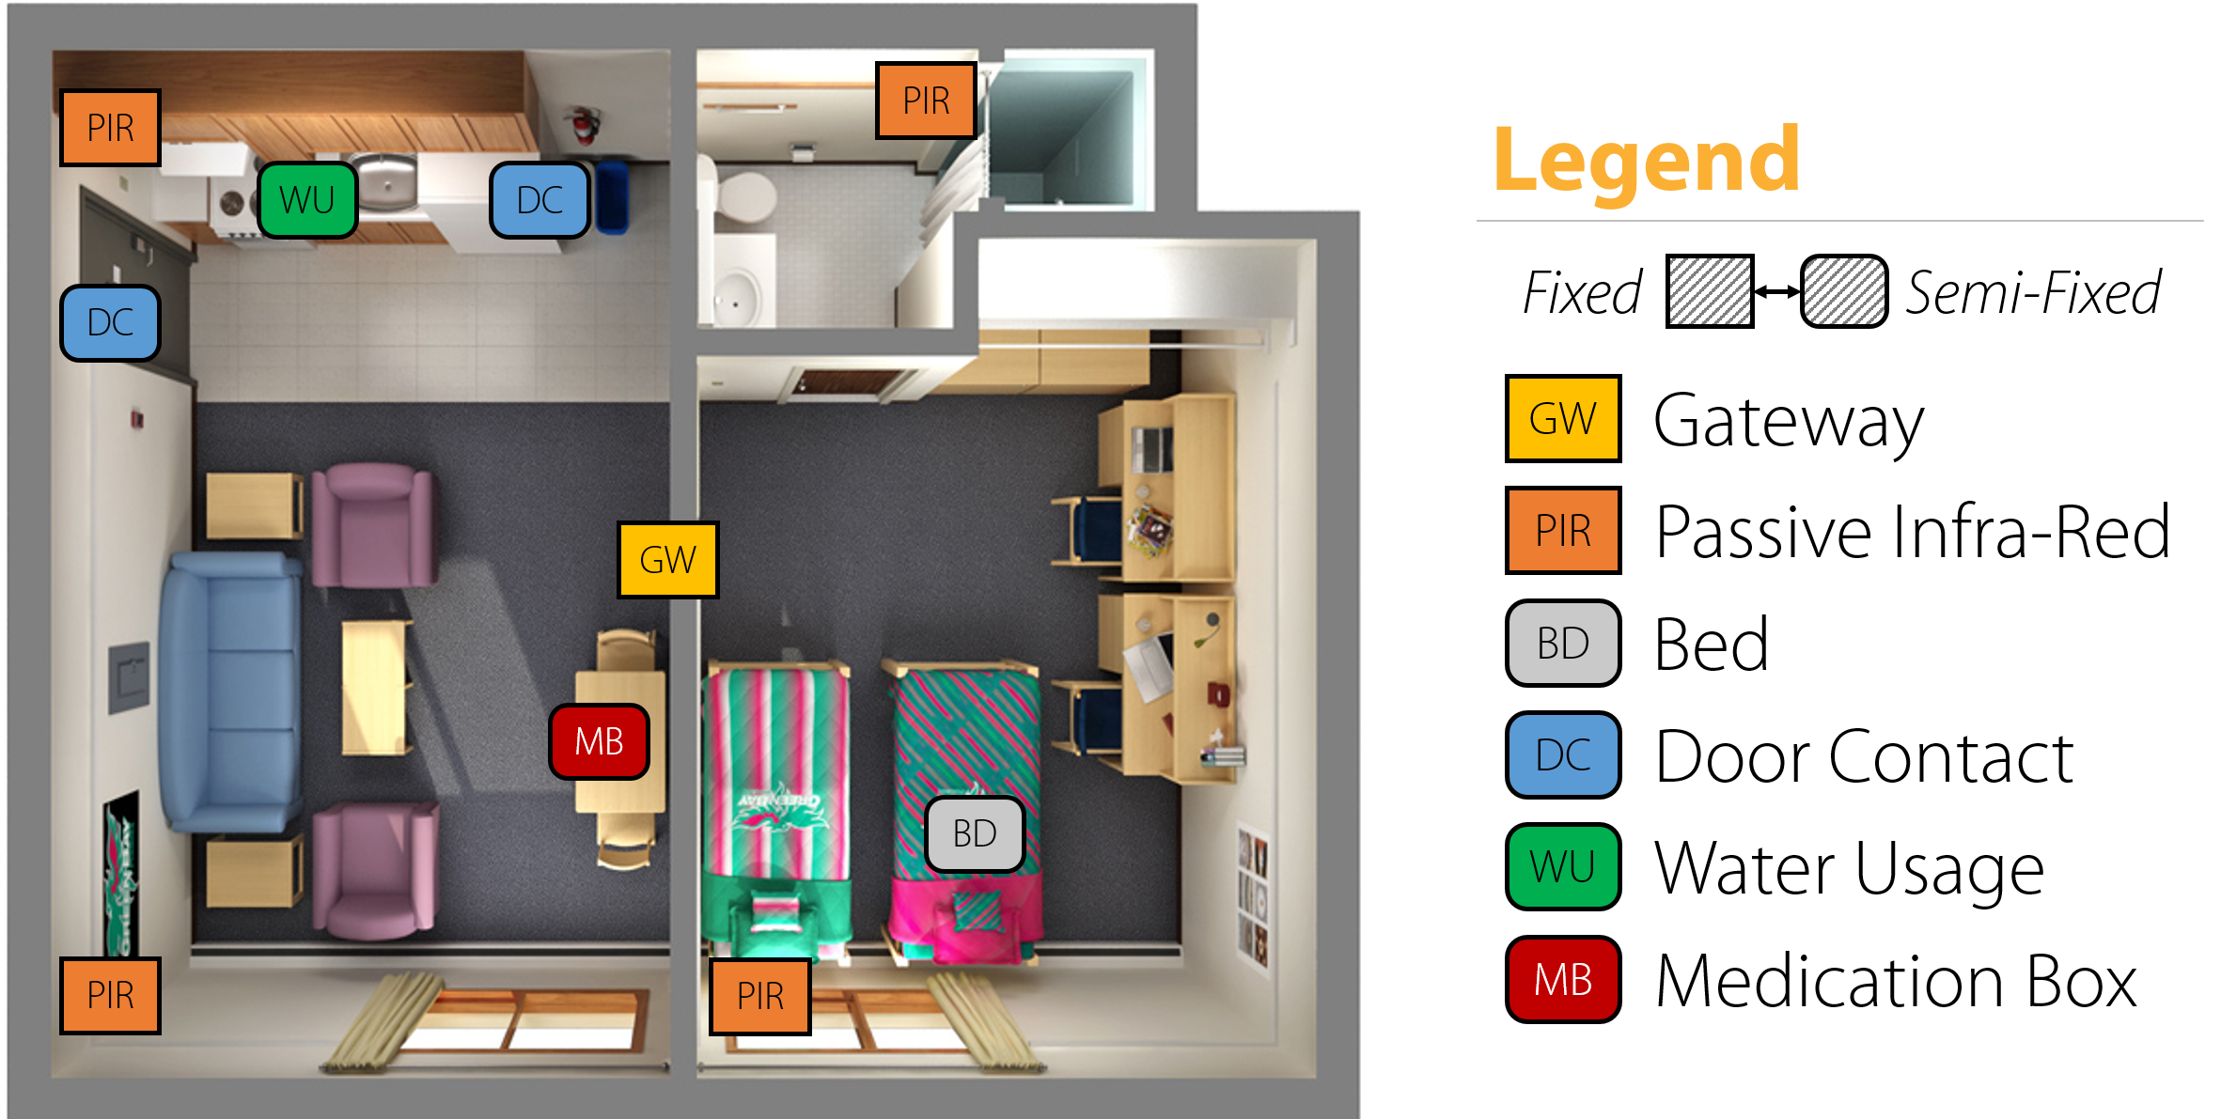
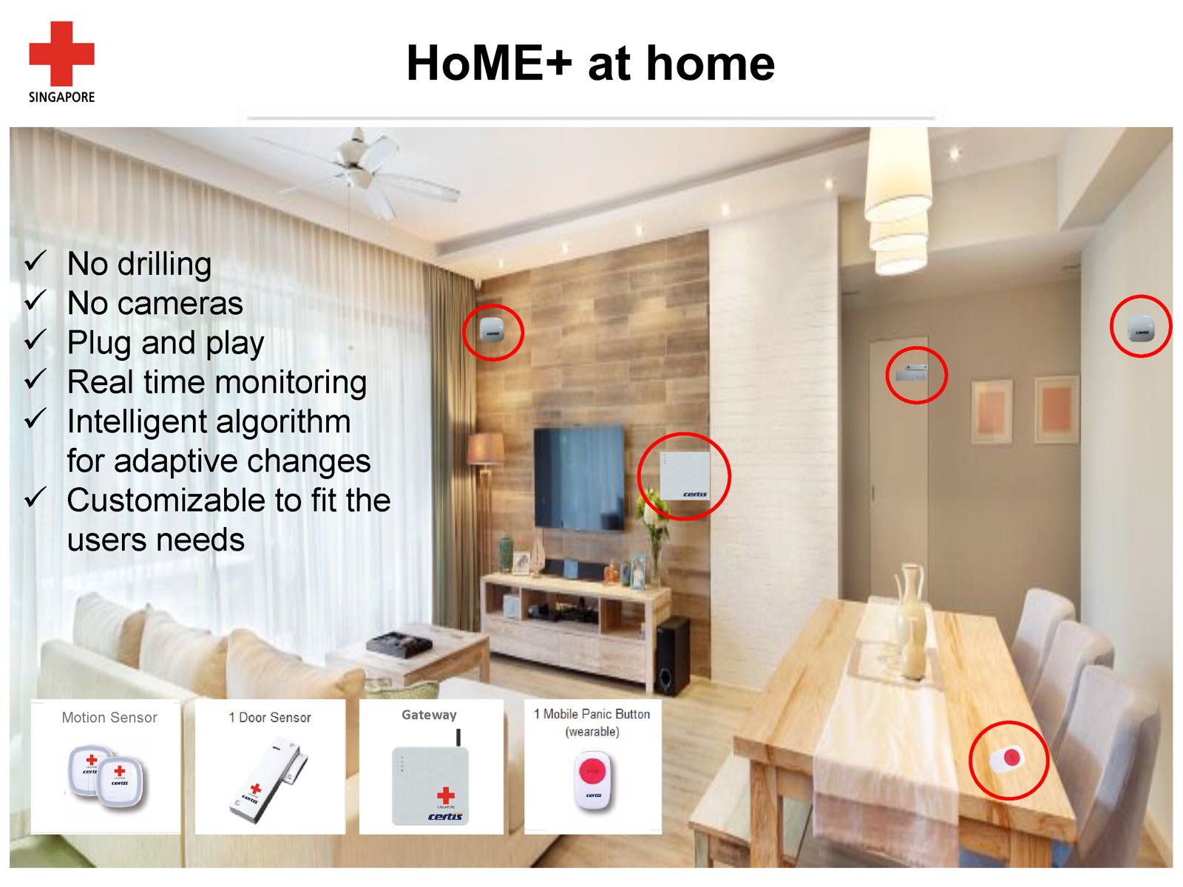
Existing Systems
SHINESeniors System
HoME+ System
GlycoLeap Application
SHINESeniors System by SMU-TCS iCity Lab
HoME+ System by Red Cross Society

Slide 6
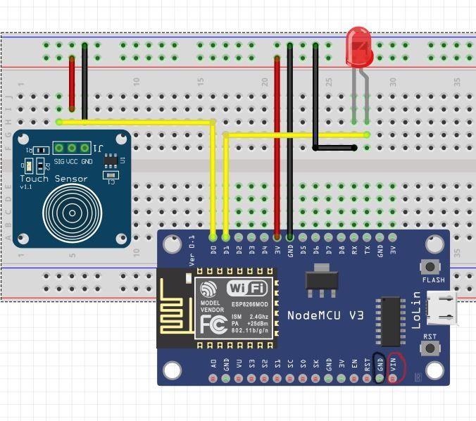
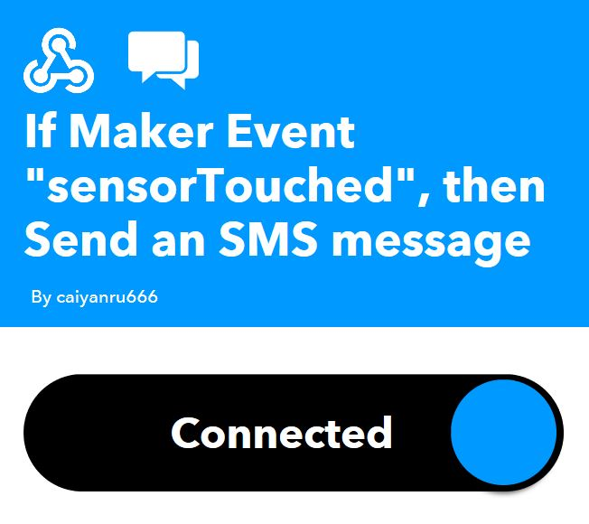
Our System (ElderTrack)
-SMS +Door Lock
SMS:
TTP223 capacitive touch sensor
ESP8266-12 Nodemcu
LED & 9V battery
IFTTT web service
Circuit Diagram
IFTTT WEB SERVICE

Slide 7
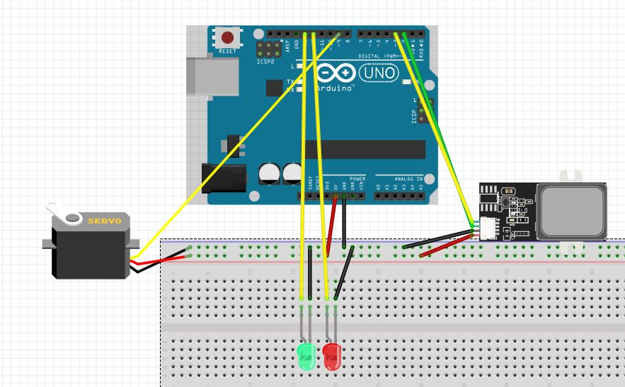
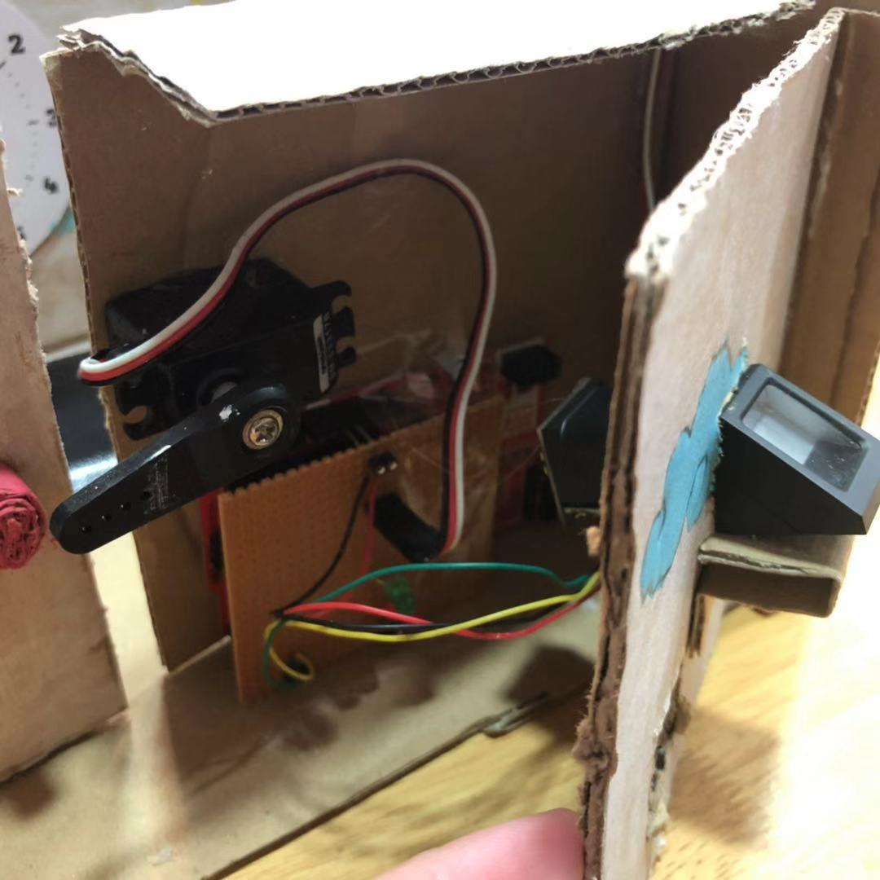
Our System(ElderTrack)
Door lock system:
Fingerprint sensor
Servo motor
Arduino
LEDs
Circuit diagram

Slide 8
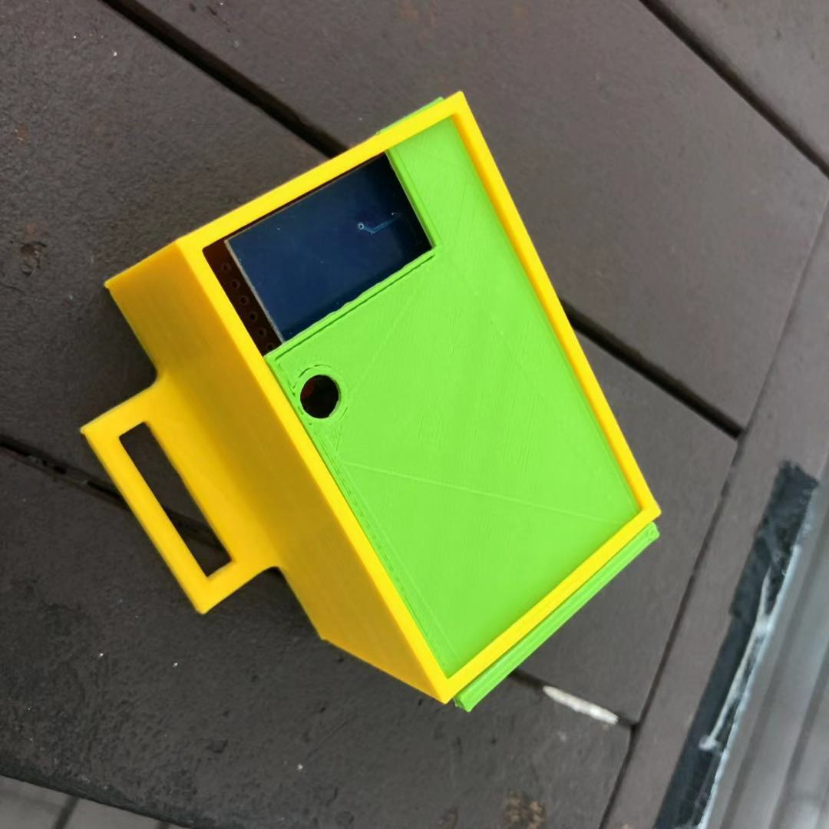

Process of System
The user will press the touch sensor for 3 seconds, and SMS will be sent for three times to alert the helpers.
Once the social worker arrives, he or she will use the fingerprint sensor to gain access into the household.

Slide 9
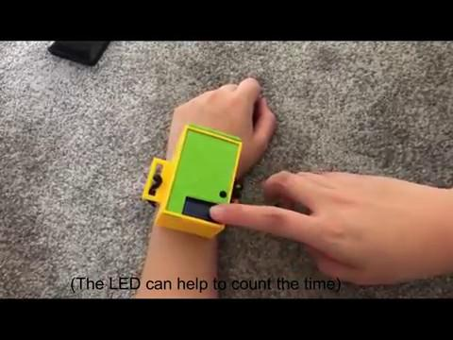
Video Demo

Slide 10
Comparison of Existing and Our System
Similarities | Differences
Has a trigger response mechanism to alert relevant authorities. | SMS System Concept .
HoME+ uses a portable ‘panic button’ similar to how we allow our system to be portable. | Uses a touch sensor instead of a conventional button.
Concept of a Smart House system | No motion detectors involved compared to the SHINESeniors system

Slide 11
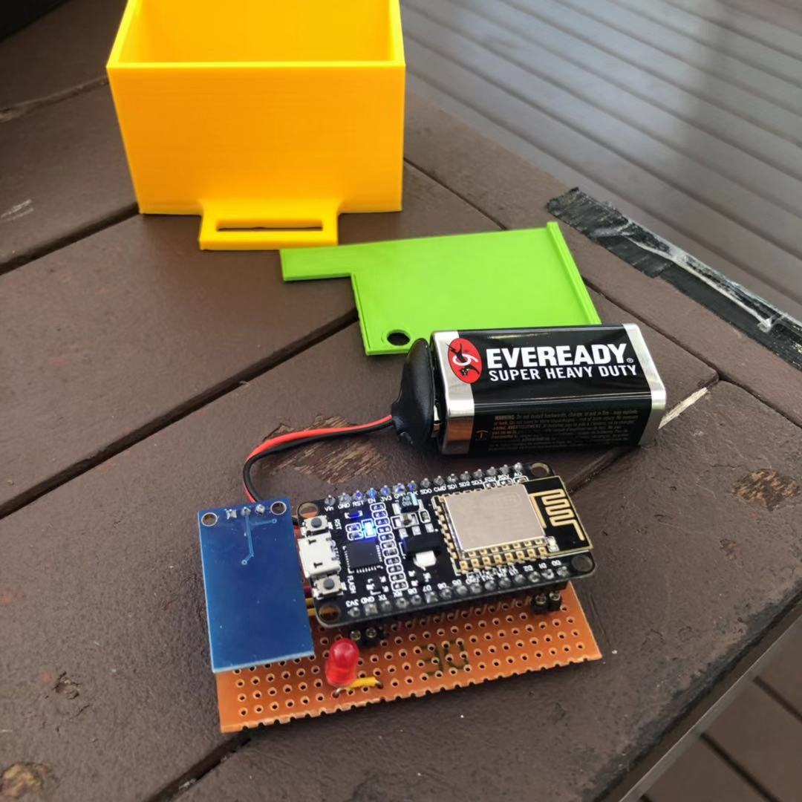
Summary and Reflections
Our system could be used to ease the process of having to call up the community centre to ask for help.
We believe that it can be improved further to be a more simple yet effective system to assist the elderly.

Slide 12
References
https://sis.smu.edu.sg/news/2018/nov/12/smu-develops-sensor-system-monitor-safety-elderly-who-live-alone
https://www.straitstimes.com/singapore/health/new-tech-for-old-folk-to-live-at-home-safely
https://www.straitstimes.com/politics/home-sensors-that-can-save-jurongs-elderly
https://www.ncbi.nlm.nih.gov/pmc/articles/PMC2586814/
https://www.tcs.com/helping-seniors-shine-on
http://www.theorycircuit.com/fingerprint-sensor-scanner-arduino/
https://randomnerdtutorials.com/fingerprint-sensor-module-with-arduino/
https://www.elecrow.com/wiki/index.php?title=Fingerprint_Sensor
https://www.instructables.com/id/ESP8266-to-IFTTT-Using-Arduino-IDE/
https://circuitdigest.com/microcontroller-projects/sending-sms-using-esp8266/
https://iotdesignpro.com/projects/iot-medicine-reminder-with-email-alert-using-esp8266
https://iotdesignpro.com/projects/iot-based-fire-alarm-project-using-esp8266

Slide 13
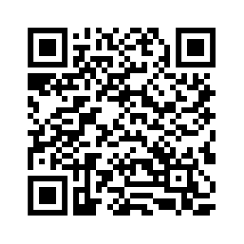
Thank you!
Any questions?
CA3 Blog on Rifaaie’s Website

